Slide 1

Motivation: From Concepts to Applications
© 2009 Prentice-Hall Inc. All rights reserved.
7-<number>

Slide 2
Chapter Learning Objectives
After studying this chapter, you should be able to:
  Describe the Job Characteristics Model and evaluate the way it motivates by changing the work environment.
  Compare and contrast the three main ways jobs can be redesigned.
  Identify three alternative work arrangements and show how they might motive employees.
  Give examples of employee involvement measures and show how they can motivate employees.
  Demonstrate how the different types of variable-pay programs can increase employee motivation.
  Show how flexible benefits turn benefits into motivators.
  Identify the motivational benefits of intrinsic rewards.
© 2009 Prentice-Hall Inc. All rights reserved.
7-<number>

Slide 3
Motivation by Job Design: The JCM
Job Characteristics Model (JCM)
  Hackman and Oldham’s concept that any job can be described through five core job dimensions:
    Skill variety – Requirements for different tasks in the job.
    Task identity – Completion of a whole piece of work.
    Task significance – The job’s impact on others.
    Autonomy – Level of discretion in decision making.
    Feedback – Amount of direct and clear information on performance.
  The way elements in a job are organized (job design) impacts motivation, satisfaction, and performance.
© 2009 Prentice-Hall Inc. All rights reserved.
7-<number>

Slide 4
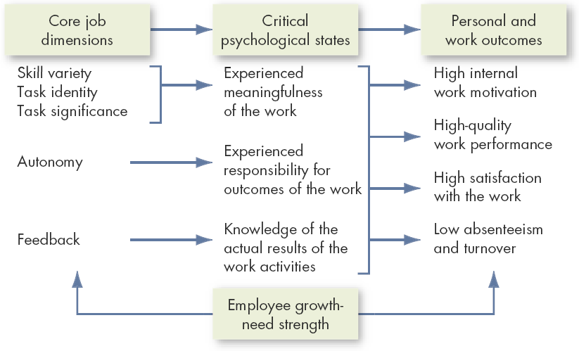
The Job Characteristics Model
Employee growth-need strength moderates the relationships.
Source: J.R. Hackman and G.R. Oldham, Work Design (excerpted from pp. 78–80). © 1980 by Addison-Wesley Publishing Co., Inc. Reprinted by permission of Addison-Wesley Longman, Inc.
E X H I B I T 7-1
© 2009 Prentice-Hall Inc. All rights reserved.
7-<number>

Slide 5
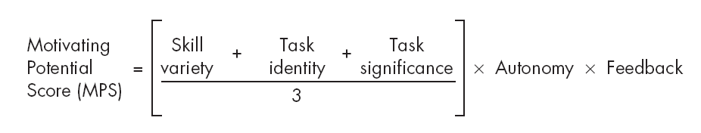
Motivating Potential Score (MPS)
Five dimensions combined into a single predictive index of motivation.
  People who work on jobs with high core dimensions are generally more motivated, satisfied, and productive.
  Job dimensions operate through the psychological states in influencing personal and work outcome variables rather than influencing them directly.
While the JCM framework is supported by research, the MPS model isn’t practical and doesn’t work well.
© 2009 Prentice-Hall Inc. All rights reserved.
7-<number>

Slide 6

How Can Jobs Be Redesigned?
Job Rotation
  The periodic shifting of a worker from one task to another
Job Enlargement
  The horizontal expansion of jobs
Job Enrichment
  The vertical expansion of jobs
© 2009 Prentice-Hall Inc. All rights reserved.
7-<number>

Slide 7
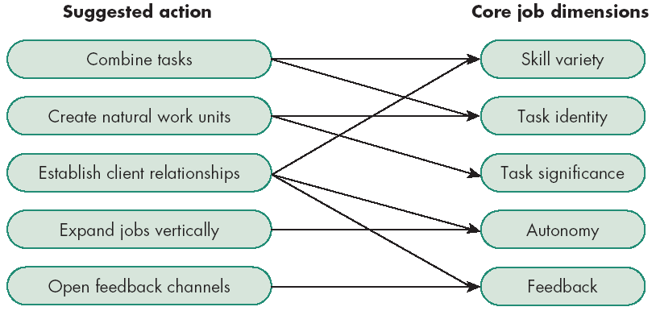
Guidelines for Enriching a Job
Source: J.R. Hackman and J.L. Suttle, eds., Improving Life at Work (Glenview, IL: Scott Foresman, 1977), p. 138.
E X H I B I T 7-2
© 2009 Prentice-Hall Inc. All rights reserved.
7-<number>

Slide 8
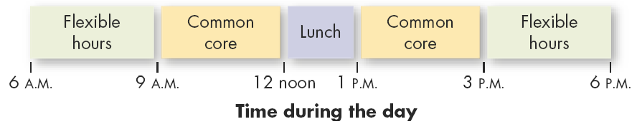
Alternative Work Arrangements
Flextime
  Employees work during a common core time period each day but have discretion in forming their total workday from a flexible set of hours outside the core.
Job Sharing
  The practice of having two or more people split a 40-hour-a-week job
E X H I B I T 7-3
© 2009 Prentice-Hall Inc. All rights reserved.
7-<number>

Slide 9

Another Alternative: Telecommuting
Telecommuting
  Employees do their work at home at least two days a week on a computer that is linked to their office.
The Virtual Office
  Employees work out of their home on a relatively permanent basis.
Typical Telecommuting Jobs
  Professional and other knowledge-related tasks
  Routine information-handling tasks
  Mobile activities
© 2009 Prentice-Hall Inc. All rights reserved.
7-<number>

Slide 10

Reasons for and against Telecommuting
Advantages
Disadvantages
  Larger labor pool
  Higher productivity
  Less turnover
  Improved morale
  Reduced office-space costs
Employer
  Less direct supervision of employees
  Difficult to coordinate teamwork
  Difficult to evaluate non-quantitative performance
Employee
  May not be as noticed for his or her efforts
© 2009 Prentice-Hall Inc. All rights reserved.
7-<number>

Slide 11
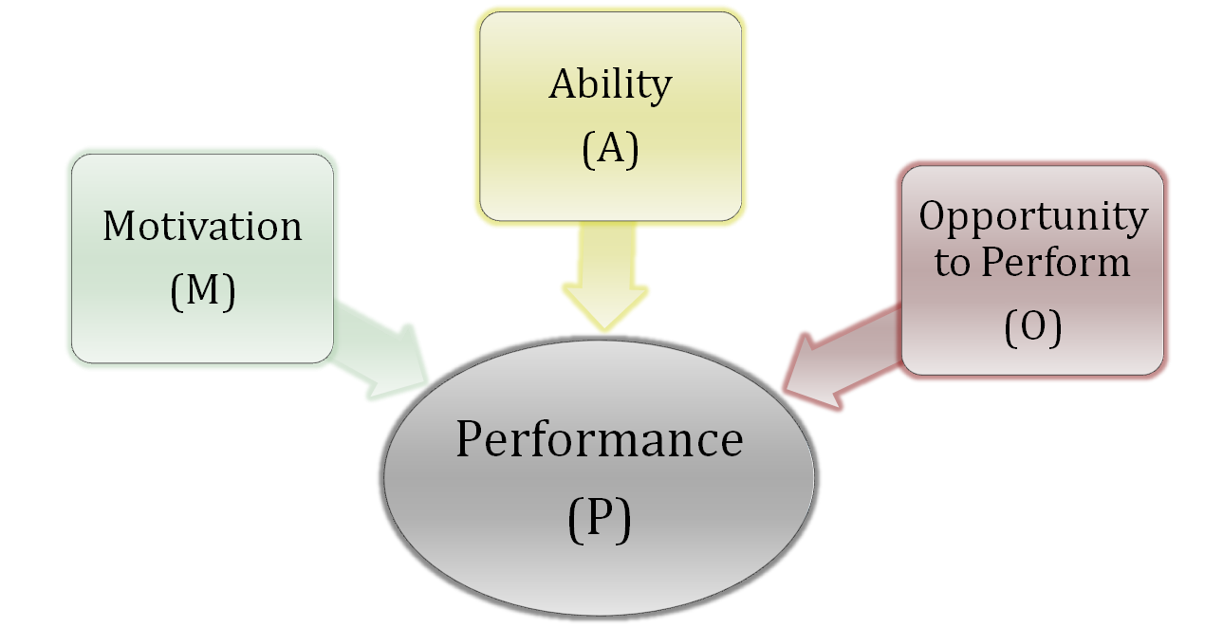
Motivation Is Not the Whole Story
P = f(A x M x O)
© 2009 Prentice-Hall Inc. All rights reserved.
7-<number>

Slide 12

Employee Involvement
A participative process that uses the input of employees to increase their commitment to the organization’s success.
By increasing worker autonomy and control over work lives (involvement), organizations:
  Increase employee motivation
  Gain greater organizational commitment
  Experience greater worker productivity
  Observe higher levels of job satisfaction
© 2009 Prentice-Hall Inc. All rights reserved.
7-<number>

Slide 13
Types of Employee Involvement Programs
Participative Management
  Subordinates share a significant degree of decision-making power with their immediate superiors
Representative Participation
  Works councils
    Groups of nominated or elected employees who must be consulted for any personnel decisions
  Board representative
    An employee sits on a company’s board of directors and represents the interests of the firm’s employees
Quality Circle
  A work group of employees who meet regularly to discuss their quality problems, investigate causes, recommend solutions, and take corrective actions
© 2009 Prentice-Hall Inc. All rights reserved.
7-<number>

Slide 14
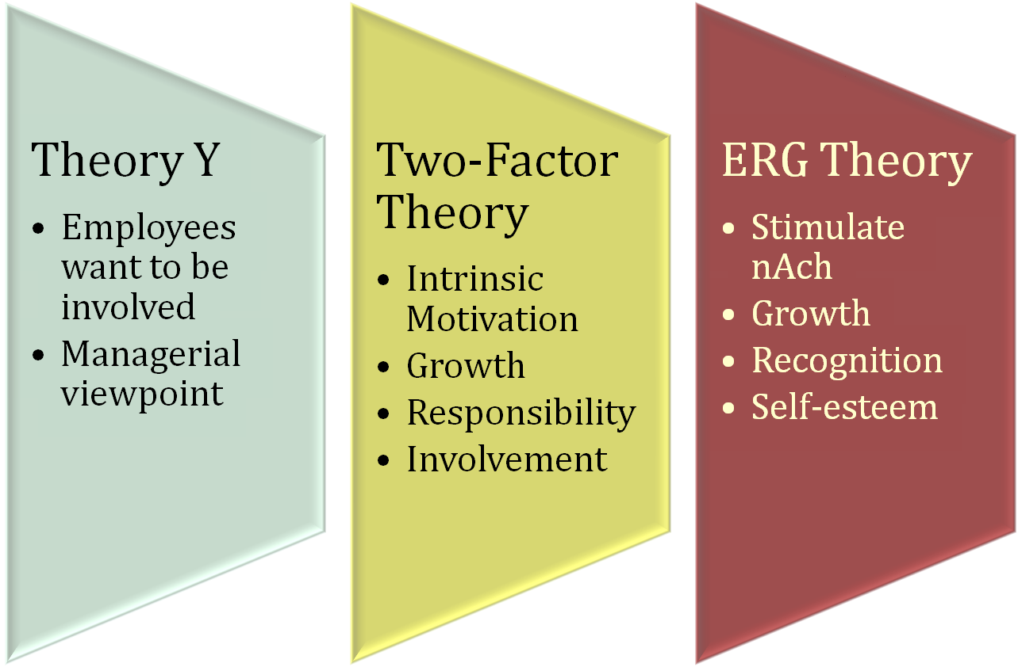
Motivational Theory Links to EI Programs
© 2009 Prentice-Hall Inc. All rights reserved.
7-<number>

Slide 15

Four Major Strategic Reward Decisions
What to pay? (pay structure)
How to pay individuals? (variable pay plans and skill-based pay plans)
What benefits to offer? Do we offer choice of benefits? (flexible benefits)
How to build recognition programs?
© 2009 Prentice-Hall Inc. All rights reserved.
7-<number>

Slide 16

1. What to Pay – Pay Structure
Internal equity
  The worth of the job to the organization
  Determined by job evaluations
External equity
  The competitiveness of the company’s pay relative to pay elsewhere in the industry
  Determined through pay surveys
Choose organizational position
  Pay leaders
    Greater employee loyalty
    Attracts better-quality employees
  Pay laggards – accept high turnover for low hourly costs
© 2009 Prentice-Hall Inc. All rights reserved.
7-<number>

Slide 17
2. How to Pay - Variable Pay Programs
Types of Variable Pay Programs
  A portion of an employee’s pay is based on some individual and/or organizational measure of performance
  Piece Rate:
    Workers are paid a fixed sum for each unit of production completed
    Weakness: not feasible for many jobs
  Merit-Based:
    Based on performance appraisal ratings
    Gap increasing between average and top-performers
    Weaknesses: validity of system based on annual appraisals, pay pool can be small, unions strongly resist
  Bonuses:
    Rewards recent performance
    Weakness: employees consider this a pay
© 2009 Prentice-Hall Inc. All rights reserved.
7-<number>

Slide 18
2. How to Pay - Skill-Based Pay Programs
Types of Skill-Based Programs:
  Also known as competency- or knowledge-based pay - sets pay based on skills or number of jobs an employee can perform
  Profit Sharing:
    Organization-wide programs that distribute compensation based on some established formula designed around a company’s profitability
  Gain Sharing:
    An incentive plan in which improvements in group productivity determine the total amount of money that is allocated
  Employee Stock Ownership Plans (ESOPs)
    Company-established benefit plans in which employees acquire stock as part of their benefits
© 2009 Prentice-Hall Inc. All rights reserved.
7-<number>

Slide 19

Evaluation of Variable and Skill-based Pay
To some extent, variable pay does increase motivation and productivity
Benefits of Skill-based Pay Plans
  Provide staffing flexibility
  Facilitate communication across the organization
  Lessen “protection of territory” behaviors
  Meet the needs of employees for advancement
  Lead to performance improvements
Drawbacks:
  Lack of additional learning opportunities
  Continuing to pay employees for obsolete skills
  Paying for skills of no immediate use to the organization
  Paying for a skill, not for performance of the skill
© 2009 Prentice-Hall Inc. All rights reserved.
7-<number>

Slide 20
3. What Benefits to Offer - Flexible Benefits
Employees tailor their benefit program to meet their personal need by picking and choosing from a menu of benefit options.
Modular Plans
  Predesigned benefits packages for specific groups of employees
Core-Plus Plans
  A core of essential benefits and a menu-like selection of other benefit options
Flexible Spending Plans
  Allow employees to use their tax-free benefit dollars to purchase benefits and pay service premiums
© 2009 Prentice-Hall Inc. All rights reserved.
7-<number>

Slide 21

4. How to Build Recognition Programs
Intrinsic Rewards: Stimulate Intrinsic Motivation
  Personal attention given to employee
  Approval and appreciation for a job well done
  Growing in popularity and usage
Benefits of Programs
  Fulfill employees’ desire for recognition
  Inexpensive to implement
  Encourage repetition of desired behaviors
Drawbacks of Programs
  Susceptible to manipulation by management
See E X H I B I T 7-4
© 2009 Prentice-Hall Inc. All rights reserved.
7-<number>

Slide 22

Global Implications
Job Characteristics and Job Enrichment
  Inconsistent results across cultures
Telecommuting
  U.S. does this more, but EU workers are interested in it
Variable Pay
  Not much research available, but some possible hypotheses on relationships
Flexible Benefits
  This concept is becoming more prevalent globally
Employee Benefits
  Practices must be modified to match culture
© 2009 Prentice-Hall Inc. All rights reserved.
7-<number>

Slide 23

Summary and Managerial Implications
To Motivate Employees
  Recognize individual differences
  Use goals and feedback
  Allow employees to participate in decisions that affect them
  Link rewards to performance
  Check the reward system for equity
© 2009 Prentice-Hall Inc. All rights reserved.
7-<number>

Slide 24

All rights reserved. No part of this publication may be reproduced, stored in a retrieval system, or transmitted, in any form or by any means, electronic, mechanical, photocopying, recording, or otherwise, without the prior written permission of the publisher. Printed in the United States of America.
Copyright ©2009 Pearson Education, Inc. Publishing as Prentice Hall

